Slide 1
ENTERPRISE RESOURCE PLANNING SYSTEM
GROUP 3
Mirabel Forchaleke
Jasmine Baltimore
Bryan Gilstrap
Larry Ginyard
Michael Mays
March 3, 2019

Slide 2

Outline
  Enterprise Resource Planning System Overview
  Case Studies Summary
    Bell and Company
    Rolls Royce
  Alternatives & Comparisons
  Benefits
  Limitations
  Best Fit
  Lifecycle
  Enterprise Architecture Preparation
  Summary
  References

Slide 3

Enterprise Resource Planning System Overview
Cloud-based application system
Increases efficiency
Provides better-quality data visibility
Reduces cost by eliminating IT staff
Notes:
Enterprise Resource Planning (ERP) system has various great aspects such as endowing businesses with the ability to conduct operations efficiently within a fast paced and changing market, helps solve many problems organizations may face, offers unified communications, better-quality data visibility, and increased efficiency and confident business decisions. ERP systems also assist with reducing cost by eliminating the need for IT staff, tons of hardware, and software programs. But like any other system there are pros and cons that should be taken into consideration before implementation. Case studies in organizations such as Bell and Company Marine Supply and Rolls Royce serve as great examples of companies that have implemented an ERP system which will be a great foundation to begin examining their advantage, disadvantages, benefits, processes, life cycles, and any recommendations provided. This is not a guide for selecting an ERP, however these key factors will assist with determining an ERP system that will meet the needs of the organization, identifying limitations, and addressing any other internal/external issues that the organization may face.

Slide 4
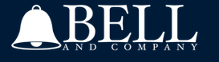
Bell and Company
Overview
Is an Industrial and Marine Supply Distributer
Located in Mobile, Alabama
Upgraded from ink and paper accounting to ERP
Increase in quality of customer service
Notes:
Bell and Company is an Industrial and Marine Supply Distributer located in Mobile, Alabama. They provide services to plant engineers, field technicians, and purchasers in the areas of measurement, control, monitoring, and generation (Bell and Company, n.d.). Bell and Company’s organization consist of various departments such as sales, purchasing, and a mechanical engineering team who offer product support and technical services to their customers.

Slide 5

Bell and Company
Issues
Automated customer service was desired
Outdated accounting technology
Unreliable business processes
Integration of third-party systems wanted
More user-friendly interfaces wanted
Notes:
At Bell and Company the issue lay largely in accounting. The company began with old-fashioned ink and paper. Then in 2008 Dan Wilkins, Company President, switched their accounts to QuickBooks which was a wise move but was still sluggish with providing superior customer service which is what he wanted the company to be known for. To compete with larger companies in the distribution sector he knew he had to upgrade to a more sophisticated ERP software.

Slide 6
Bell and Company
Enabled a more modern accounting system
Improved customer service
Improved employees' productivity
Integrated many functional systems
ERP Success Factors
Notes:
Bell and Company (B&C) had to upgrade to a more sophisticated ERP software. The business chose Acumatica’s cloud-based ERP, this proved a success because of its ease of use. Small companies such as B&C could adopt and host it in the cloud and save money by not having to buy new hardware or servers. Dan Wilkins, Company President, acknowledged implementing the ERP software as a success. He credited that to eliminated the many hats he had to wear such as the co-owner, the president, salesman, purchasing agent, and the IT department. As a small business, they didn’t have the luxury of a robust IT department like bigger companies often have access to. Implementing the ERP software allowed them the ability to integrate and configure it with their accounting system and customize the software to meet the needs of the business.

Slide 7
Bell and Company
Lessons
Learned
Upgrading systems is vitally important
No IT staff were needed
The solution was low cost
Increased productivity
ERP improved upon customer service issues
Notes:
The President of Bell and Company, after immense research, found a seemingly tailormade solution to his company’s issues. His chosen ERP solution mirrored his needs and its implementation was seamless. The ERP system assisted Bell and Company to seek improvement in their employee's productivity and gain competitive advantage (Ullah, 2017).

Slide 8

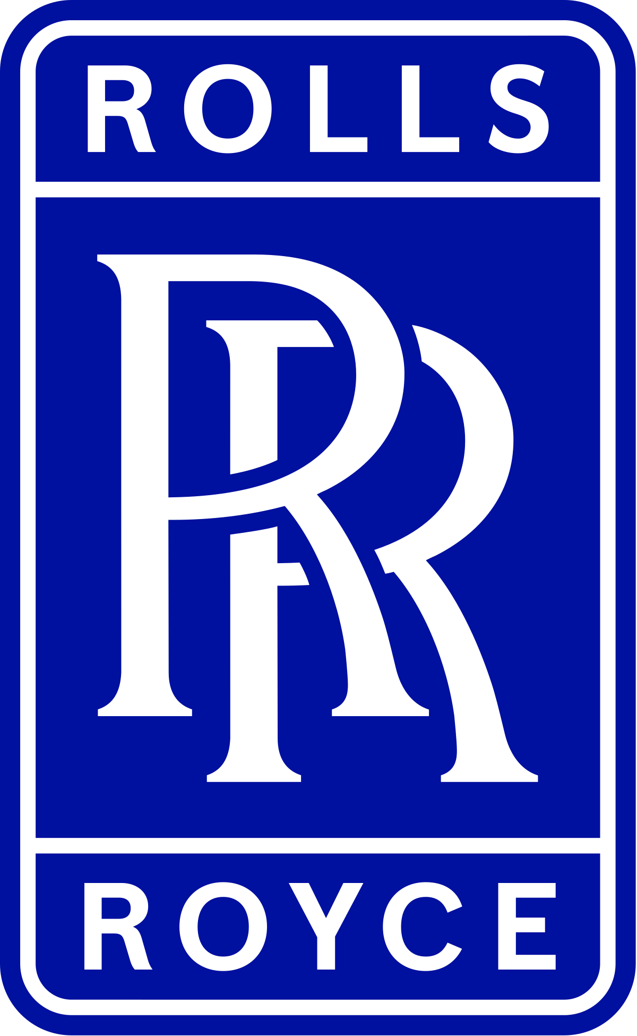
Rolls Royce
Overview
Established in 1904
Worldwide Presence (Operates in 50 countries)
New acquisitions lead to dramatic increase in size
1500 systems, mostly internally developed
Notes:
Rolls-Royce (RR) is a global business that specializes in manufacturing and distribution for various industries such as aviation, nuclear power, and marine applications. It has facilities in over 14 different countries and offers first-rate after sales services, covering mechanical overhauls and spare part distribution (Yusuf, 2004).
Since 1904, the Rolls-Royce Company has created an icon with their handmade luxury cars embodying the dreams of Charles Rolls and Henry Royce. RR designs, develops, manufactures and services integrated power systems for use in the air, on land and at sea. They are one of the world’s leading producers of aviation engines for large civil aircraft and corporate jets. The are the second largest provider of defense aviation engines and services in the world.
In 1989, they purchased the Allison Engine Company that pioneered the aero propulsion and gas turbines (Yusuf, Gunasekaran, & Abthorpe, 2004). Rolls-Royce has a competitive environment from GE Aviation Systems, Safran and Pratt and Whitney Engine Services as potential threats. A new organizational structure was put in place to better meet their customer’s needs.

Slide 9
Rolls Royce
Issues
Plethora of fragmented systems in need of integration
Operation and upkeep of so many systems was expensive and difficult
Accuracy, accessibility, and consistency was a problem in legacy systems
Division of labor was deeply compartmentalized resulting in counterproductive isolation
Lack of communication between sites
Old systems caused stock problems, due to poor tracking of work in progress
Systems for finance and procurement had problematic interface between file formats
Legacy systems did not support company agility in a competitive and changing environment
Notes:
When considering the case of Rolls-Royce, the company at one time had over 1500 systems in use before implementing ERP. The systems were a nightmare of information stovepipes, where nothing was interconnected. Once they chose an ERP, the transition became a full shift in how the company did business. They fully outsourced the IT department to Electronic Data Services (EDS) who inherited the job of integrating SAP’s ERP for RR.

Slide 10
Rolls Royce
ERP Success Factors
Cultural
  The resistance to change for many employees was overcome by ease of use and greater ability to communicate internally
Business
  Outsourcing the problem to Electronic Data Services (EDS) brought a valuable external perspective
  EDS was effective at choosing a reliable and efficient system in SAP ERP
Technical
  Complex business processes had to be summarized, effects were assessed throughout entire business
  Data migration was equivalent to ten medium sized business joining into one
Notes:
Rolls Royce joined forces with EDS company to find solutions to manage information and resources. The EDS implemented an SAP ERP on operational business unit (OBU). Moving from the old systems to the new required more resources than expected, hence more risk. The company had successes such as reliable and efficient systems and they had failures such as accommodations problems. The company had a large complex business process and the project had to assess the effects throughout the whole business, which was equivalent to ten medium sized companies pulling together as one. This caused administrative difficulties, particularly in the first phase of the project, whilst setting the strategy and overall direction (Yusuf, 2004).

Slide 11
Rolls Royce
Lessons Learned
Rolls Royce correctly applied a step by step implementation approach instead of a big-band approach
Overcoming employee resistance to change was a critical successful factor
Roll Royce reduced the implementation cost by modifying the current business processes to fit in the SAP ERP best practice
Notes:
1. Roll Royce SAP project included three phases which were implemented in sequence to reduce the risk and cost of failure. The most important benefit is allowing the new system to phase in step by step without hindering the old legacy system and daily business process.
2. Overcoming the employees’ resistance to change is one of the critical successful factors because it measures the acceptance level of the Roll Royce’s employee toward the SAP R/3 implementation project.
3. Roll Royce is one of the giants in engineering industry, a business sector which features different commercial needs and uses different competitive advantages against its leading competitors. The highly standardized business process may help Rolls Royce to reduce running cost and increase production efficiency.

Slide 12
Alternatives & Comparisons
Bell and Company
Rolls Royce

Slide 13
Benefits
Bell and Company
Rolls Royce

Slide 14
Limitations
Bell and Company
Rolls Royce

Slide 15
Best Fit
Bell and Company
Rolls Royce

Slide 16
Life Cycle

Slide 17
Enterprise Architect
Preparations

Slide 18
Summary

Slide 19
References
Successful ERP Implementation: Bell and Company. (n.d.). Retrieved from Acumatica: https://www.acumatica.com/success-stories/erp-system-for-bell-and-company/
Ullah, A., Baharun, R. B., Nor, K., MD, Siddique, M., & Bhatti, M. N. (2017). Enterprise Resource Planning (ERP) Systems and ERP Quality Factors: A Literature Review. Journal of Managerial Sciences, 11, 297–322. Retrieved from http://ezproxy.umuc.edu/login?url=http://search.ebscohost.com.ezproxy.umuc.edu/login.aspx?direct=true&db=bth&AN=130384034&site=eds-live&scope=site
Yusuf, Y., Gunasekaran, A., & Abthorpe, M. S. (2004). Enterprise information systems project implementation:. A case study of ERP in Rolls-Royce. International Journal of Production Economics, 87, 251–266. https://doi-org.ezproxy.umuc.edu/10.1016/j.ijpe.2003.10.004

